Slide 1
AUGMENTED REALITY DASHBOARDS
Jaime Arana
1

Slide 2
Contents
1
2
3
4
What is AR?
Types of AR
AR in the car industry
Conclusion
Types of AR
Quick introduction and basic concepts about AR
What different types of AR exist nowdays
From the technology NOW to the near future
Sum up and limitations
8

Slide 3
1
Introduction
Introduction to Augmented Reality

Slide 4
2
What is AR?
Basic concepts and caracteristics of Augmented Reality

Slide 5
3
Types of AR
Basic types of Augmented Reality that exist nowadays

Slide 6
4
AR in the car industry
How is the technology used nowadays

Slide 7
AR used NOW
Inside
Navigation Systems
Basic Dashboard
Heads-up displays (HUD)
Customer service
Interactive presentations
Car customization
Virtual guides/showrooms
Manufacturing
Prototyping and testing
7

Slide 8
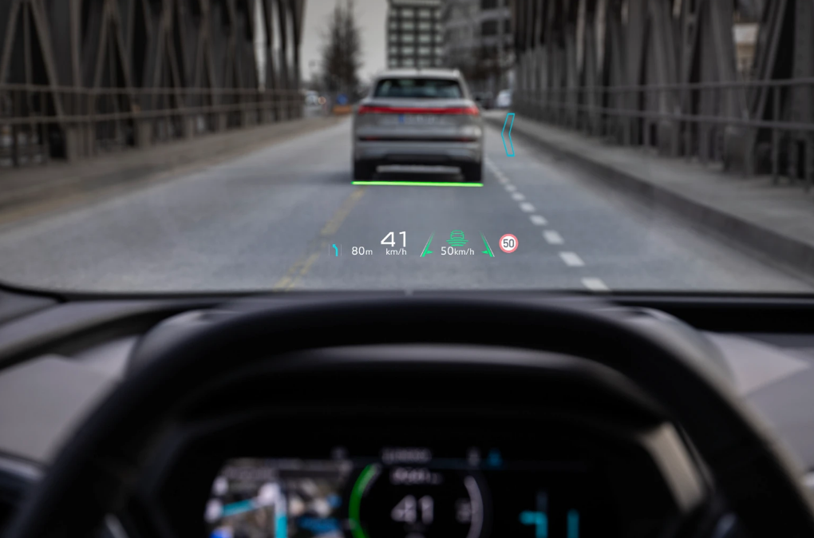
AUDI Q4 e-tron

Slide 9
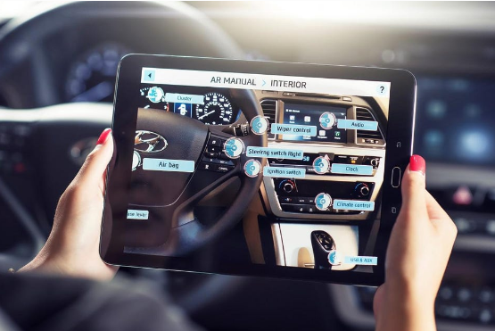
Hyundai virtual guide app/showroom

Slide 10
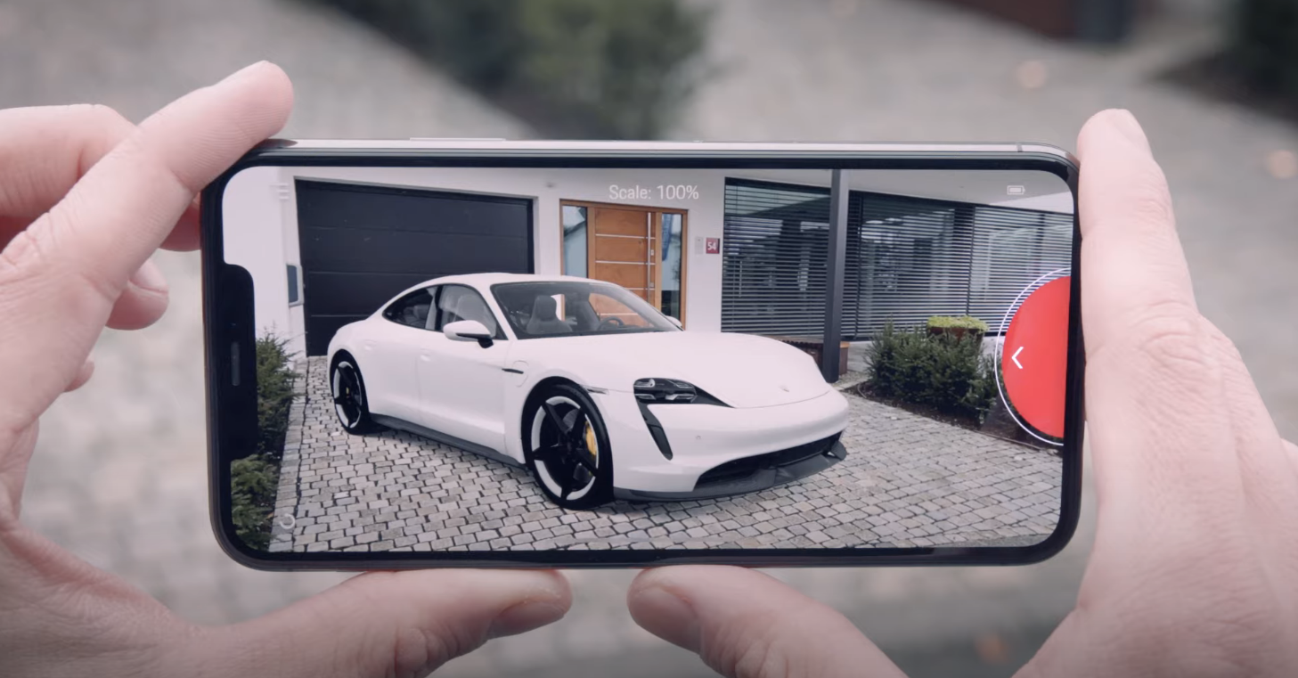
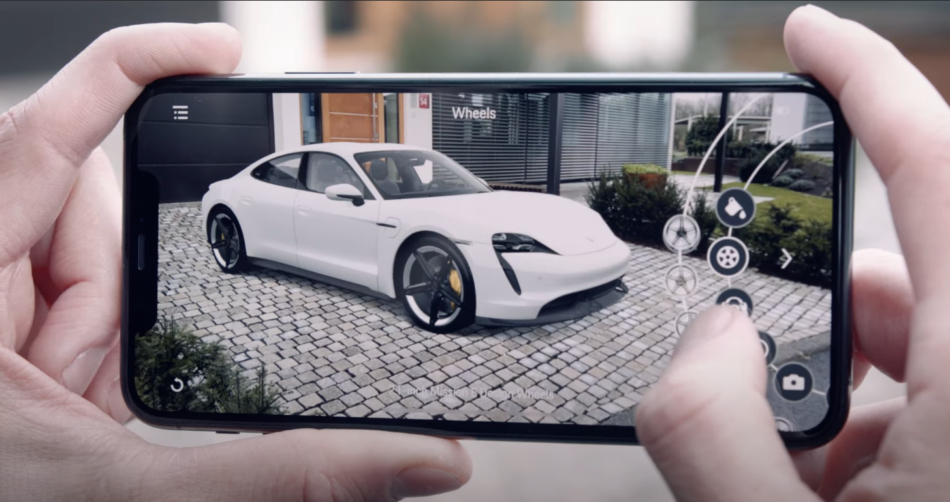
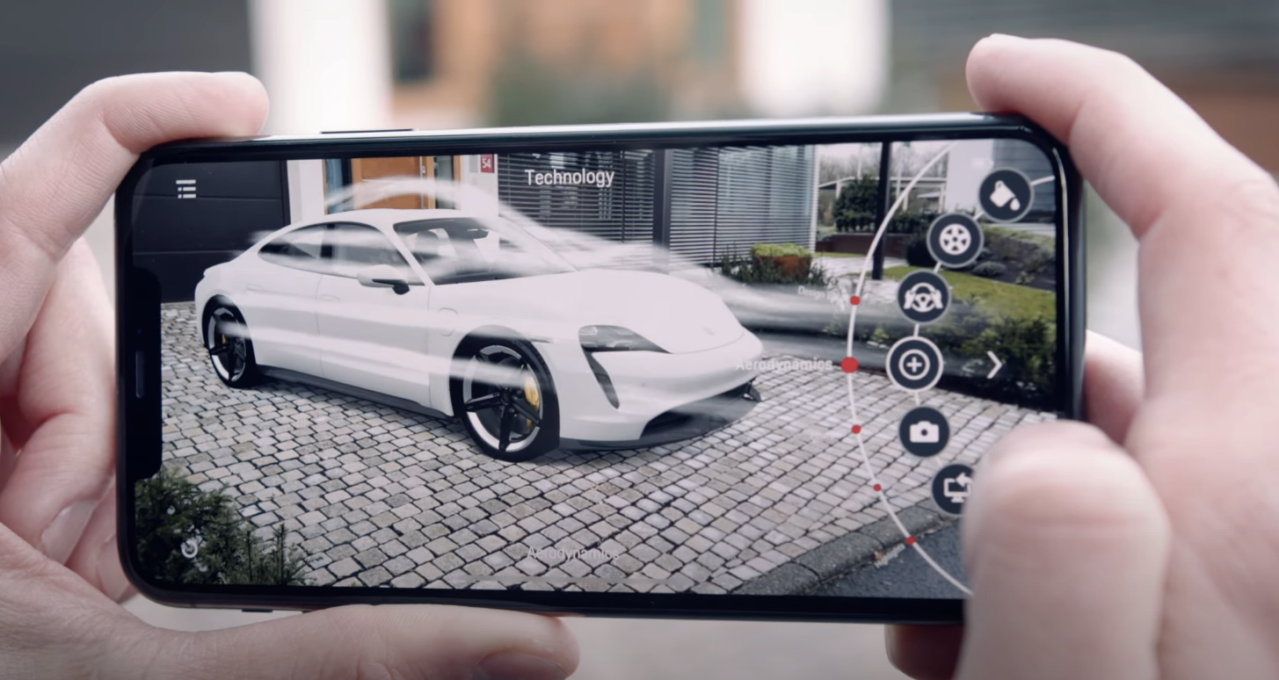
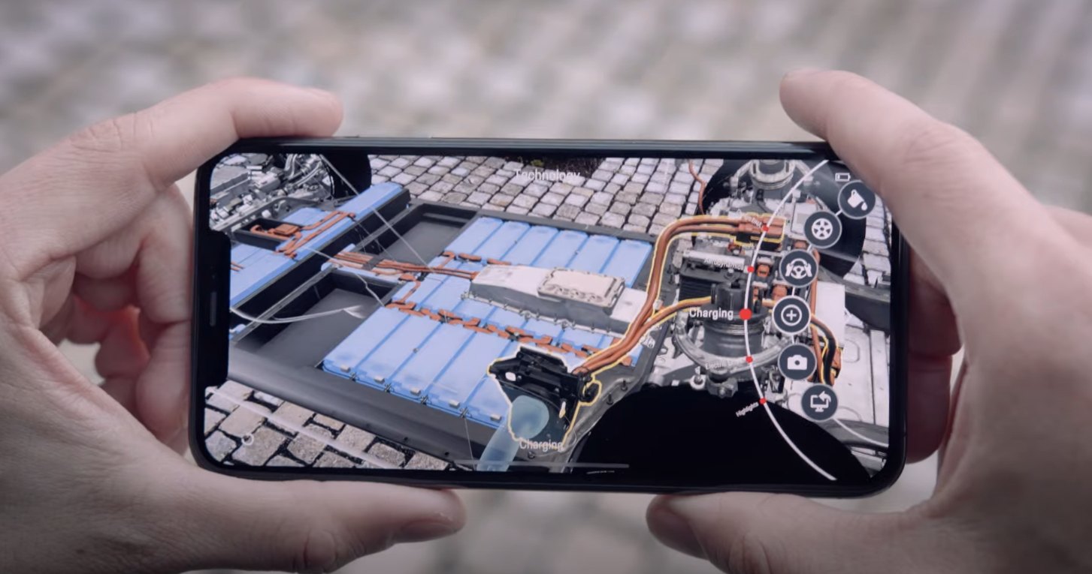
Porsche virtual guide app

Slide 11
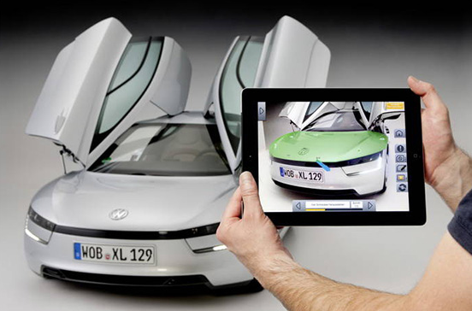
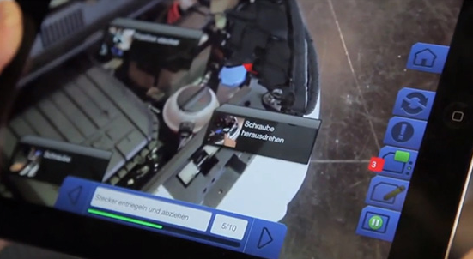
Volkswagen MARTA

Slide 12
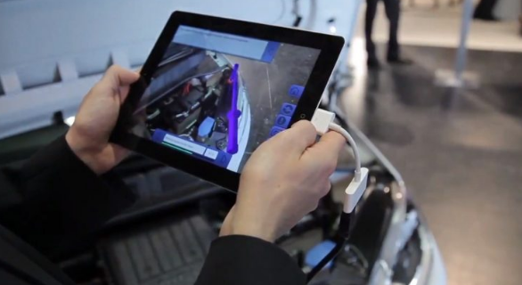
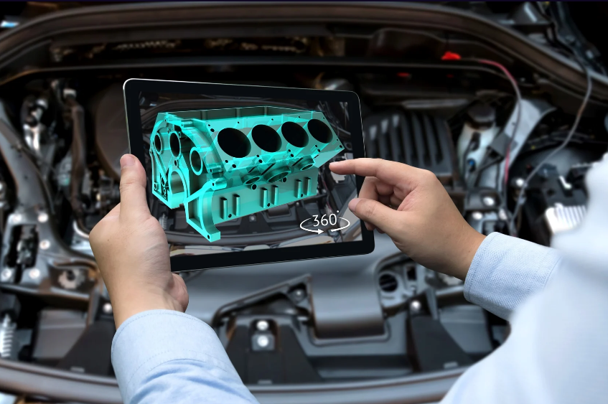
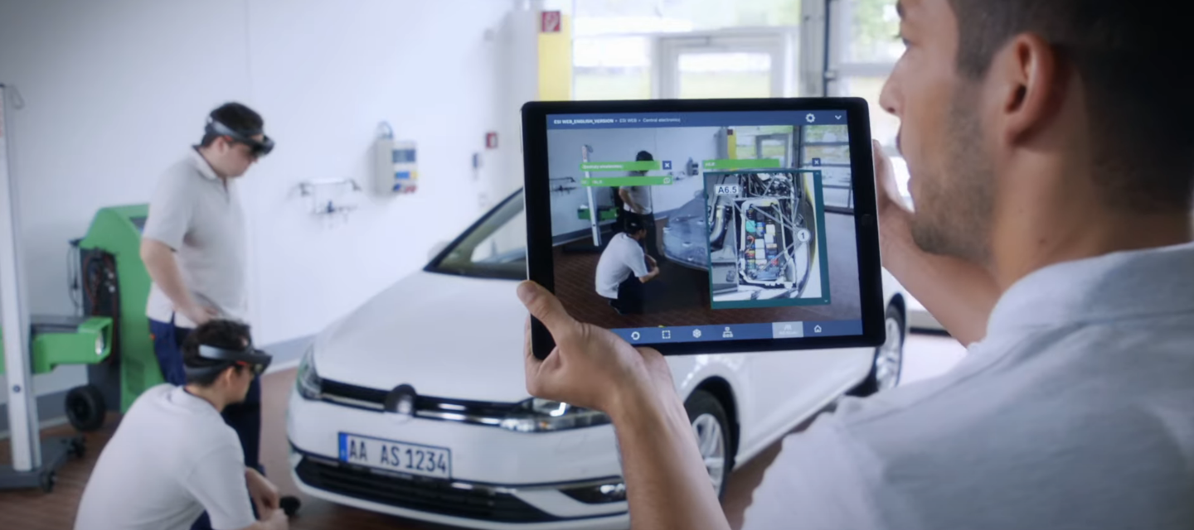
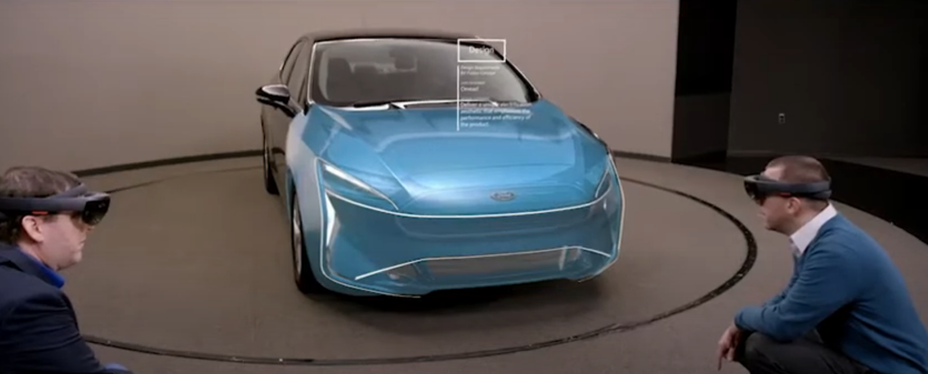
Repair help for technicians
Testing & Prototyping
Training
Showrooms

Slide 13
5
The future of AR
The use of AR in the near future

Slide 14
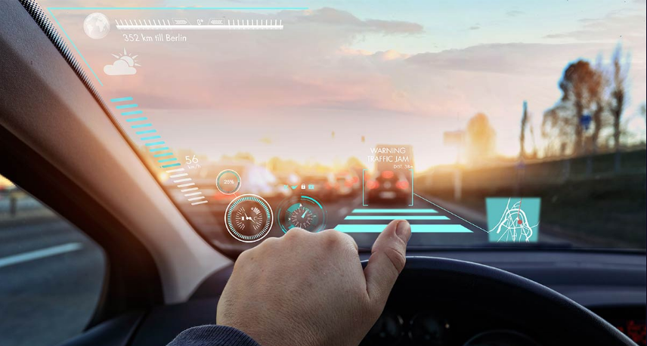

Slide 15
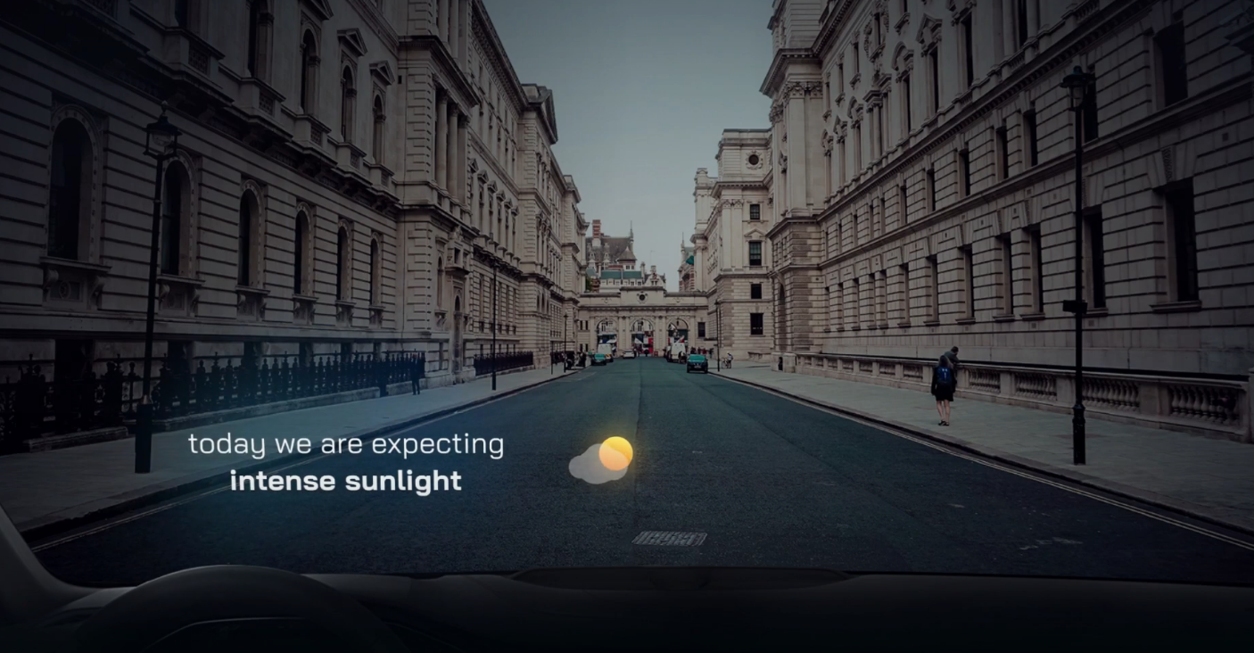
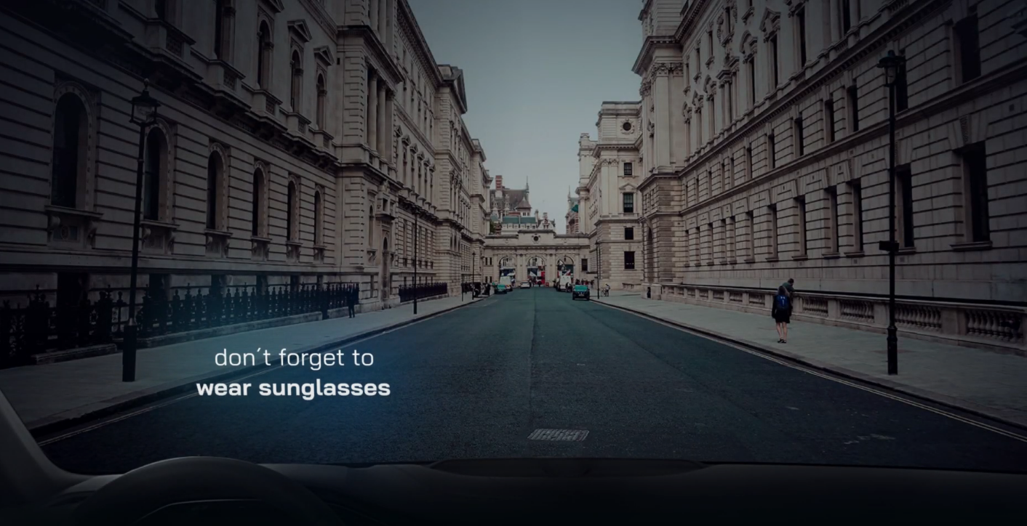
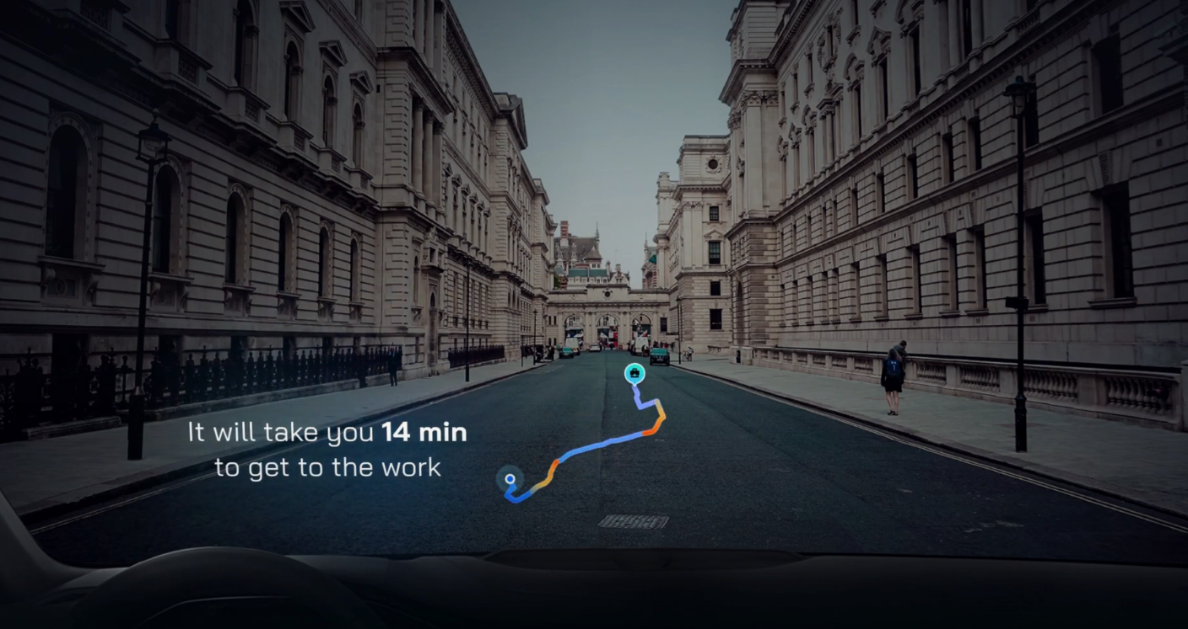
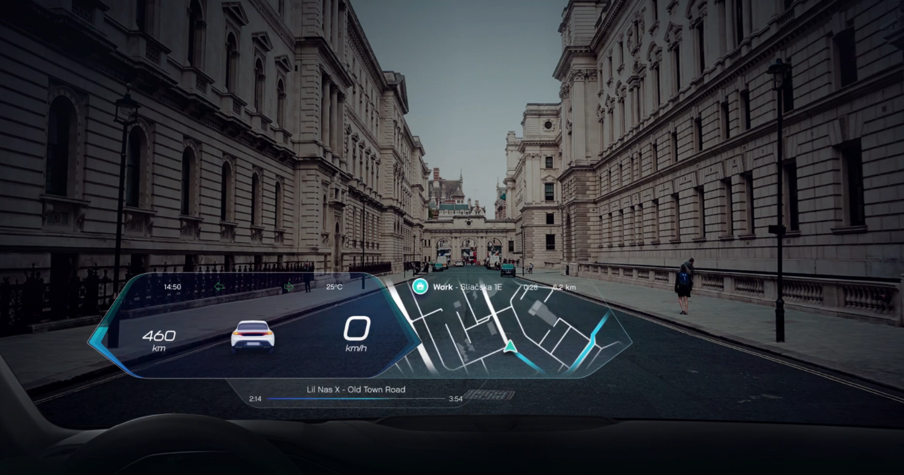

Slide 16
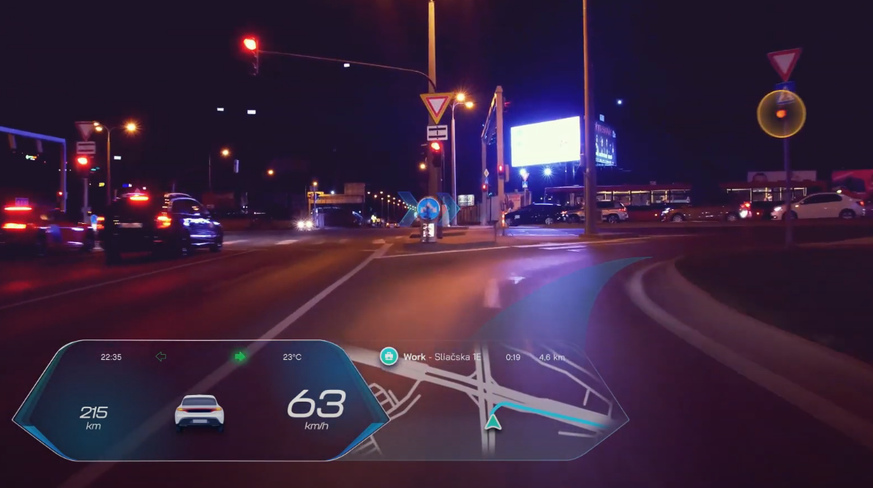
Road awareness & Directions

Slide 17
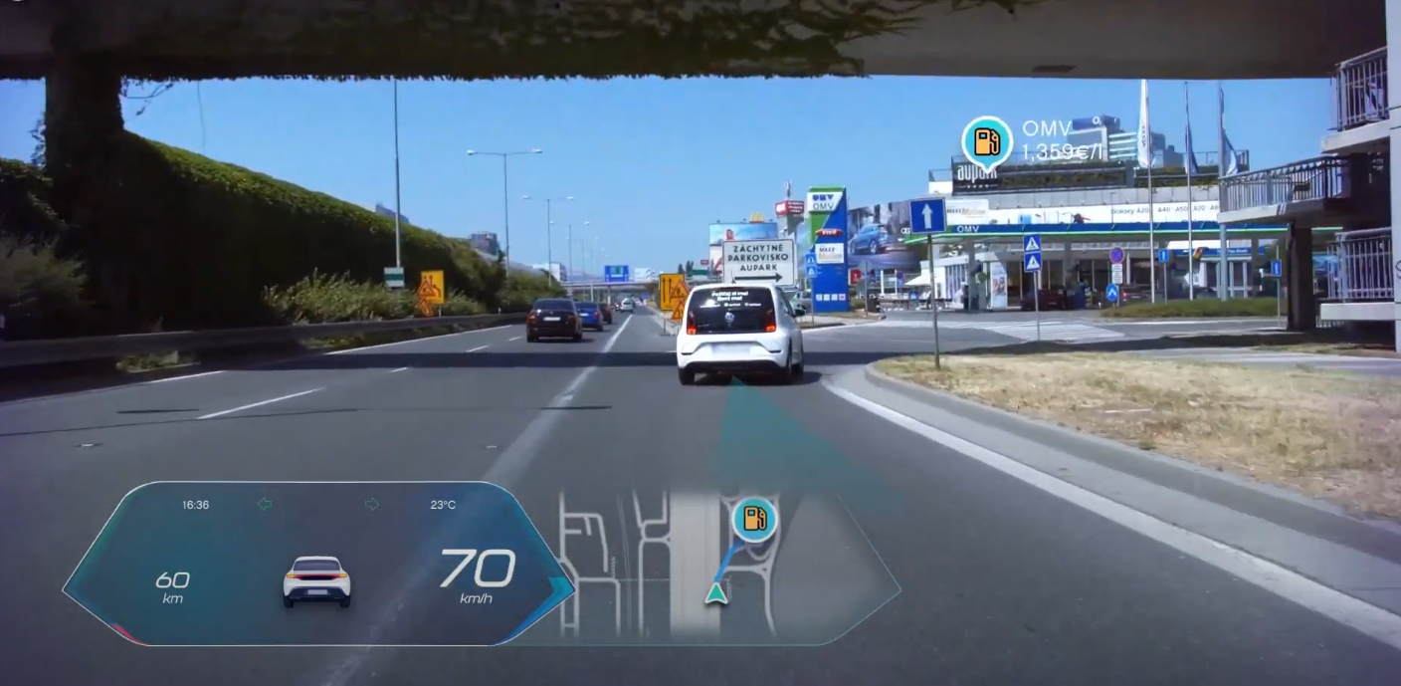
Live points of interest

Slide 18
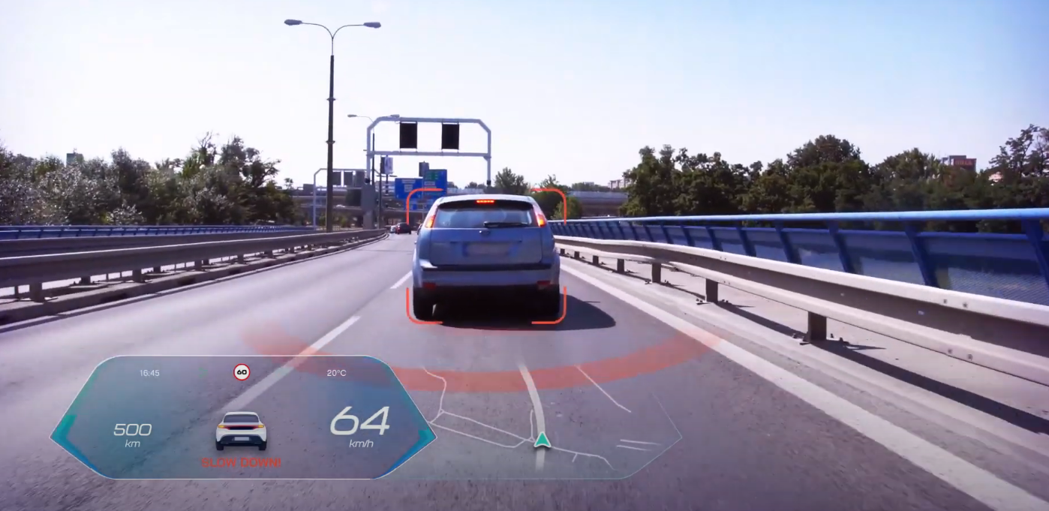
Surroundings awareness

Slide 19
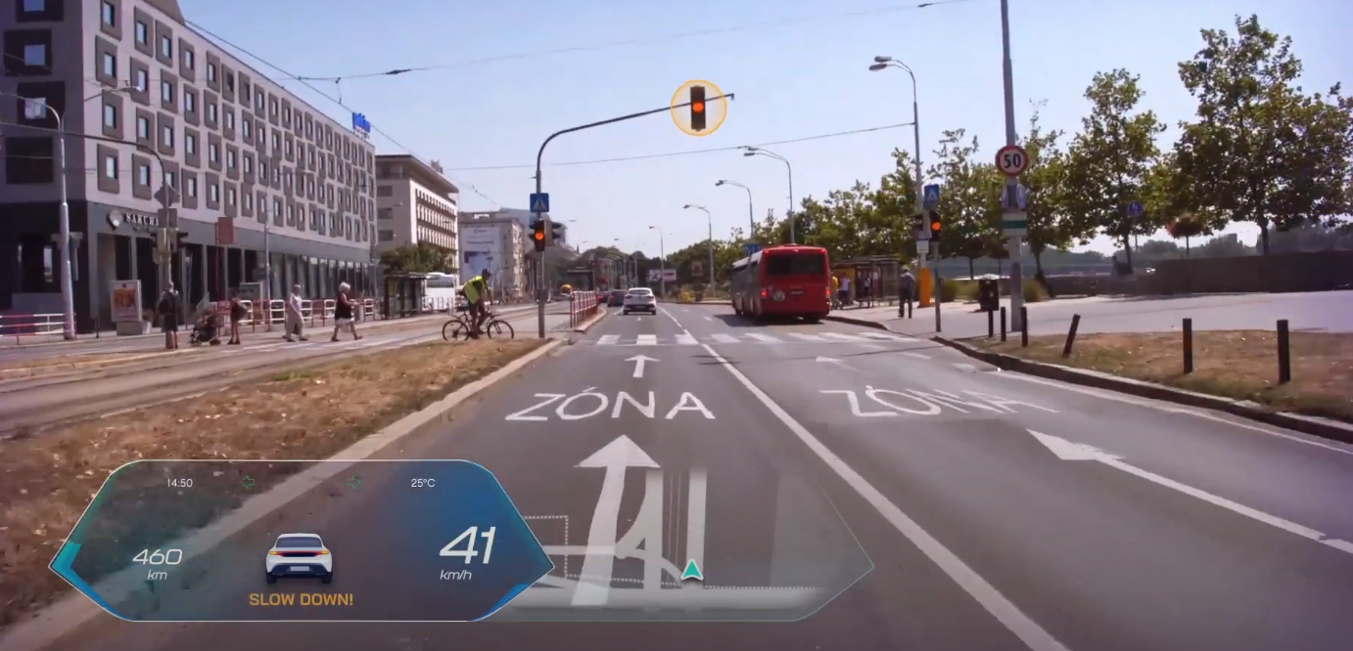
Extra set of eyes

Slide 20
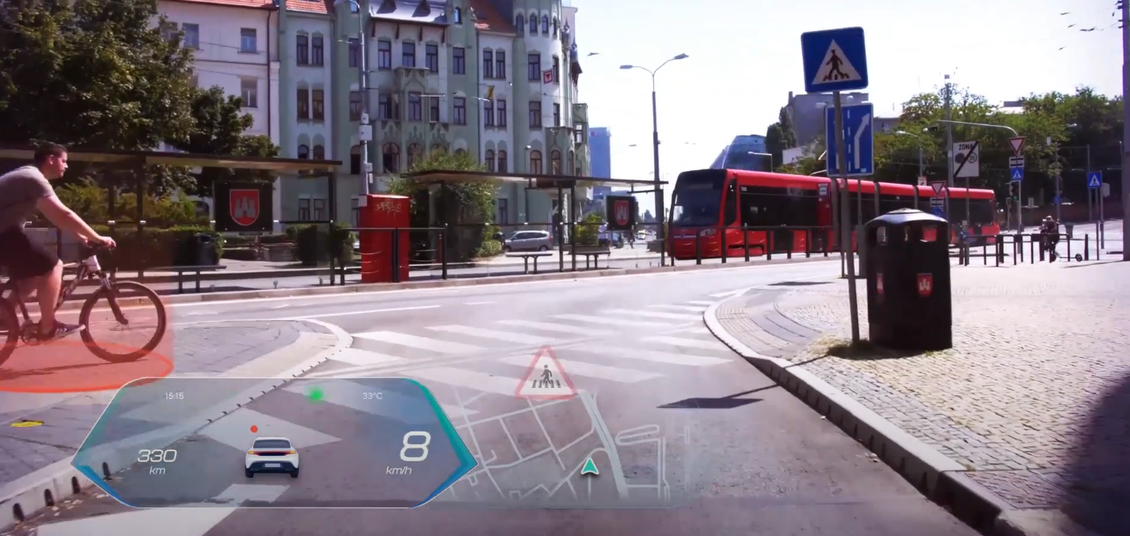
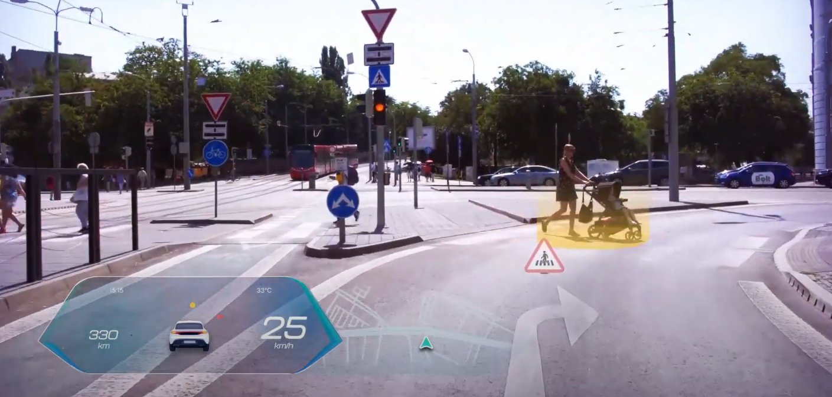
Pedestrians security

Slide 21
6
Limitations
Limitations of AR and problems

Slide 22
Thank you
Any questions?
45

Slide 23
References
https://www.youtube.com/watch?v=jPqN78-sbWo&ab_channel=PLATFORM
https://wear-studio.com/augmented-reality-in-automotive/
https://plat4m.com/future-of-ar-in-cars/
https://www.diariomotor.com/tecmovia/2013/10/09/volkswagen-marta-un-nuevo-aliado-en-las-tareas-de-mantenimiento-del-coche/
https://www.tomtom.com/blog/navigation/augmented-reality-creates-seamless-driving-experience/
23

Slide 24




"Cuando no hay luz se pueden ver estrellas"
-Sen Senra (Nos dará alas)
Cercanía tecnología
Aplausos a sanitarios
Iniciativas esperanzadoras
Bajada de
emisiones
4

Slide 25
Costes de mobile app
NAME | COMPLEXITY | IMPORTANCE | DEV HOURS | PRICE (€)
Java | 4.5 | 5 | 250 | 7.500
Integration | 4 | 5 | 125 | 3.750
Push notifs | 3 | 2 | 75 | 2.250
25

Slide 26
24.750€ + 200€/mes
23.250€ + 1.500€ MyFitnessPal API + 200€/mes Stripe (100 clientes y 50 profs)
+
13.500€
App
=
38.250€ + 200€/mes

Slide 27
Clientes
Primer mes gratis + 75€/mes (70% más barato)
Profesionales
gratis + 15% por cliente
Premium
C : 120€/mes (50% más barato)
P: 20%cliente
27

